Slide 1
Writing middleware for use in Express apps
Overview
Middleware functions are functions that have access to
the request object (req),
the response object (res), and
the next function
in the application’s request-response cycle. The next function is a function in the Express router which, when invoked, executes the middleware succeeding the current middleware.
Middleware functions can perform the following tasks:
Execute any code.
Make changes to the request and the response objects.
End the request-response cycle.
Call the next middleware in the stack.
If the current middleware function does not end the request-response cycle, it must call next() to pass control to the next middleware function. Otherwise, the request will be left hanging.

Slide 2
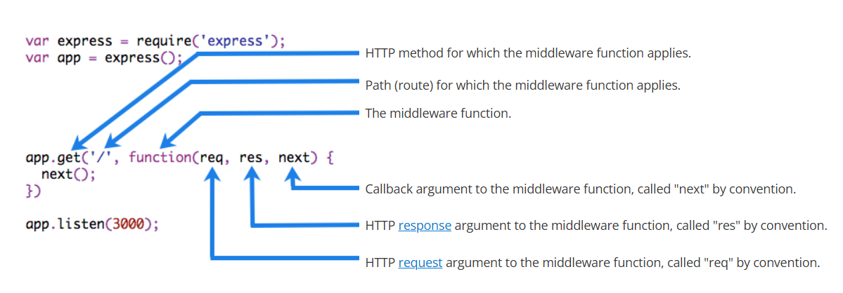
The following figure shows the elements of a middleware function call:

Slide 3
Using Express middleware
Express is a routing and middleware web framework that has minimal functionality of its own: An Express application is essentially a series of middleware function calls.
Middleware functions are functions that have access to the request object (req), the response object (res), and the next middleware function in the application’s request-response cycle. The next middleware function is commonly denoted by a variable named next.
Middleware functions can perform the following tasks:
Execute any code.
Make changes to the request and the response objects.
End the request-response cycle.
Call the next middleware function in the stack.
If the current middleware function does not end the request-response cycle, it must call next() to pass control to the next middleware function. Otherwise, the request will be left hanging.

Slide 4
How Middleware Works in the Request-Response Cycle
Middleware functions are executed in the order they are defined, creating a pipeline through which requests flow.
Each middleware function can perform operations on the request and response objects and decide whether to pass control to the next middleware or end the request-response cycle.
Lifecycle of a Request Through Middleware:
Request received by the server
Passed through each middleware in sequence
Route handler processes the request
Response flows back through middleware (in reverse order)
Response sent to client
The basic pattern of middleware in Express.js follows this structure:
app.use((req, res, next) => {
// Middleware code goes here
console.log('Time:', Date.now());
// Call next() to pass control to the next middleware function
next();
});
When you call next(), the next middleware in the stack is executed.
If you don't call next(), the request-response cycle ends and no further middleware runs.

Slide 5
const express = require('express');
const app = express();
// First middleware
app.use((req, res, next) => {
console.log('Middleware 1: This always runs');
next();
});
// Second middleware
app.use((req, res, next) => {
console.log('Middleware 2: This also always runs');
next();
});
// Route handler
app.get('/', (req, res) => {
res.send('Hello World!');
});
app.listen(8080, () => {
console.log('Server running on port 8080');
});
When a request is made to the root path ('/'), the following happens:
Middleware 1 logs a message and calls next()
Middleware 2 logs a message and calls next()
The route handler responds with "Hello World!"

Slide 6
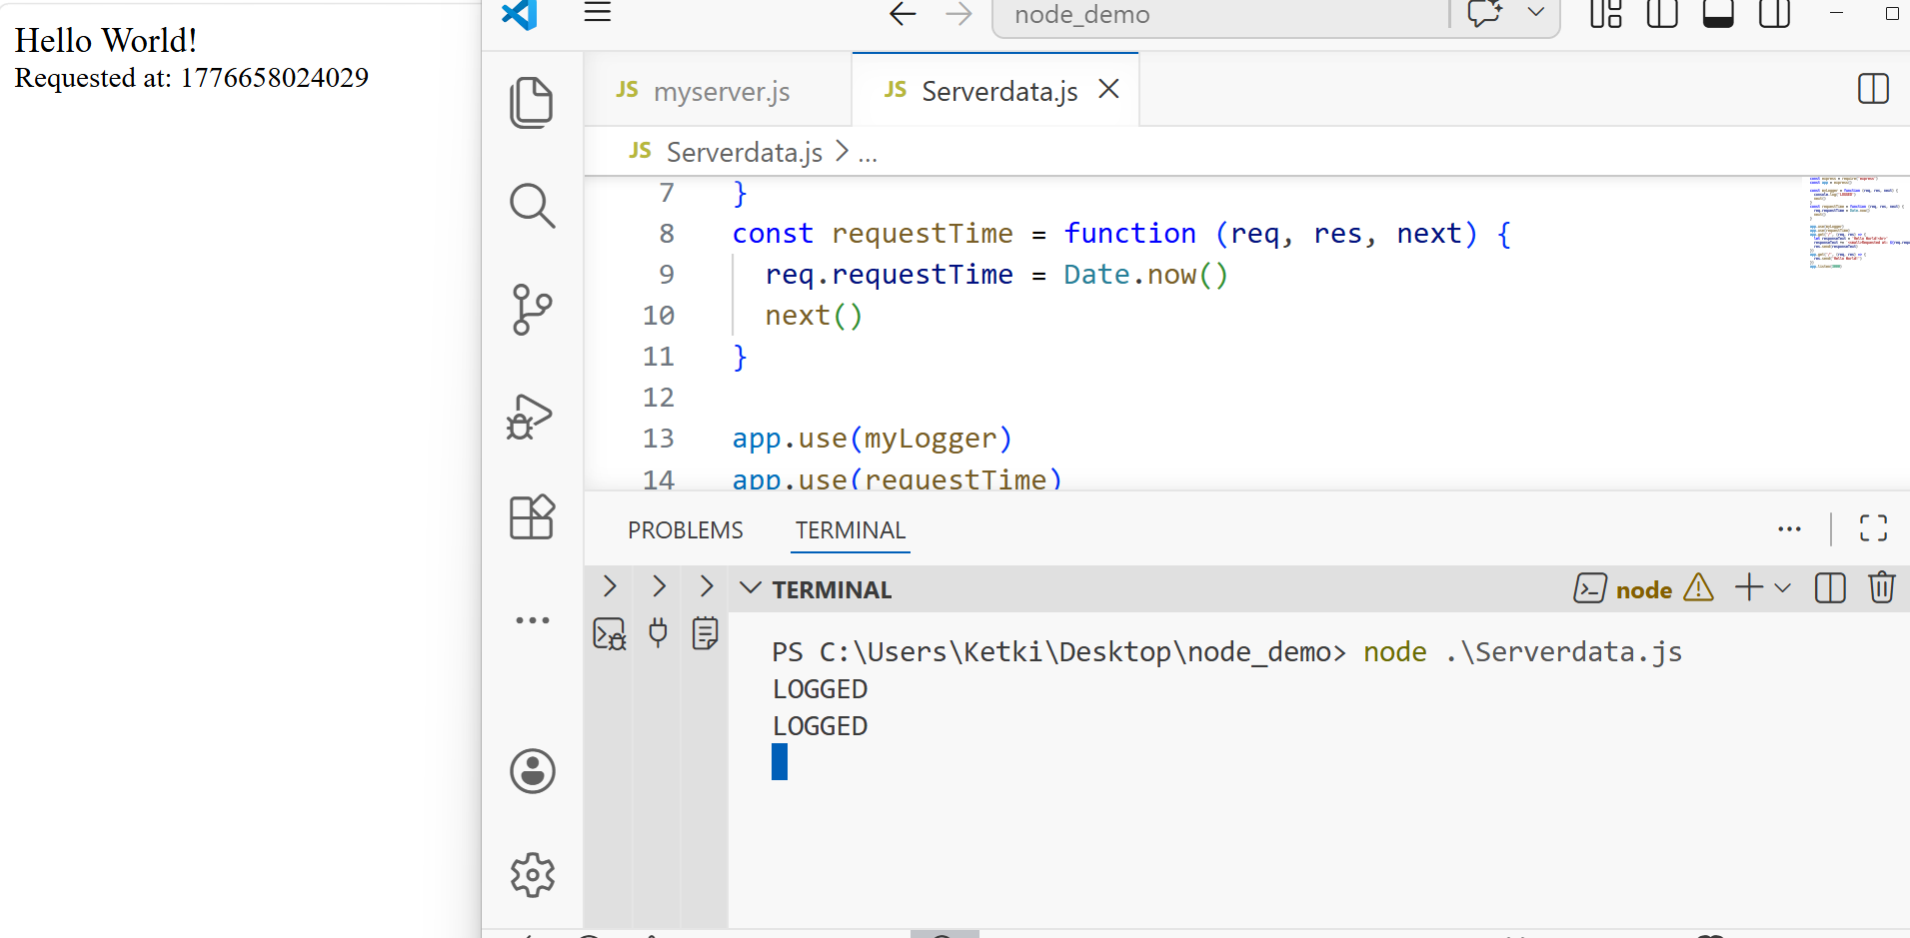
const express = require('express')
const app = express()
const myLogger = function (req, res, next) {
console.log('LOGGED')
next()
}
const requestTime = function (req, res, next) {
req.requestTime = Date.now()
next()
}
app.use(myLogger)
app.use(requestTime)
app.get('/', (req, res) => {
let responseText = 'Hello World!<br>'
responseText += `<small>Requested at: ${req.requestTime}</small>`
res.send(responseText)
})
app.get('/', (req, res) => {
res.send('Hello World!')
})
app.listen(3000)
This will short-circuit the middle ware
This middleware will never get called

Slide 7
An Express application can use the following types of middleware:
Application-level middleware
Router-level middleware
Error-handling middleware
Built-in middleware
Third-party middleware
Application-level middleware
Bind application-level middleware to an instance of the app object by using the app.use() and app.METHOD() functions,
where
METHOD is the HTTP method of the request that the middleware function
handles (such as GET, PUT, or POST) in lowercase.
const express = require('express')
const app = express()
app.use((req, res, next) => {
console.log('Time:', Date.now())
next()
})
This example shows a middleware function with no mount path. The function is executed every time the app receives a request.

Slide 8
app.get('/user/:id', (req, res, next) => {
res.send('USER')
})
The function handles GET requests to the /user/:id path.
This is application-level route

Slide 9
Middleware Execution Order
The order in which middleware is defined matters significantly.
Express executes middleware in the order they are added to the application.
const express = require('express');
const app = express();
// This middleware will run first
app.use((req, res, next) => {
console.log('First middleware');
next();
});
// This middleware will run for /users paths only
app.use('/users', (req, res, next) => {
console.log('Users middleware');
next();
});
// This route handler will run when matched
app.get('/users', (req, res) => {
res.send('Users list');
});
// This middleware will never run for successfully matched routes
// because route handlers end the request-response cycle
app.use((req, res, next) => {
console.log('This will not run for matched routes');
next();
});
// This is a "catch-all" middleware for unmatched routes
app.use((req, res) => {
res.status(404).send('Not found');
});
Best practices for middleware order:
Place middleware that applies to all requests first (logging, security, body parsing)
Place more specific middleware and routes next
Place error-handling middleware last

Slide 10
Built-in middleware
Starting with version 4.x, Express no longer depends on Connect. The middleware functions that were previously included with Express are now in separate modules; see the list of middleware functions.
Express has the following built-in middleware functions:
express.static serves static assets such as HTML files, images, and so on.
express.json parses incoming requests with JSON payloads. NOTE: Available with Express 4.16.0+
express.urlencoded parses incoming requests with URL-encoded payloads. NOTE: Available with Express 4.16.0+
Best Practice: Always use the built-in middleware when possible as they are well-tested and maintained by the Express team.
express.static(root, [options])
This is a built-in middleware function in Express. It serves static files and is based on serve-static.
The root argument specifies the root directory from which to serve static assets. The function determines the file to serve by combining req.url with the provided root directory. When a file is not found, instead of sending a 404 response, it instead calls next() to move on to the next middleware, allowing for stacking and fall-backs.

Slide 11
[options])
roperty | Description | Type | Default
dotfiles | Determines how dotfiles (files or directories that begin with a dot “.”) are treated. | String | “ignore”
etag | Enable or disable etag generation(entity tag) NOTE: express.static always sends weak ETags. | Boolean | true
extensions | Sets file extension fallbacks: If a file is not found, search for files with the specified extensions and serve the first one found. Example: ['html', 'htm']. | Mixed | false
fallthrough | Let client errors fall-through as unhandled requests, otherwise forward a client error. | Boolean | true
immutable | Enable or disable the immutable directive in the Cache-Control response header. If enabled, the maxAge option should also be specified to enable caching. The immutable directive will prevent supported clients from making conditional requests during the life of the maxAge option to check if the file has changed. | Boolean | false
index | Sends the specified directory index file. Set to false to disable directory indexing. | Mixed | “index.html”
lastModified | Set the Last-Modified header to the last modified date of the file on the OS. | Boolean | true
maxAge | Set the max-age property of the Cache-Control header in milliseconds or a string in ms format. | Number | 0
redirect | Redirect to trailing “/” when the pathname is a directory. | Boolean | true
setHeaders | Function for setting HTTP headers to serve with the file. | Function
acceptRanges | Enable or disable accepting ranged requests. Disabling this will not send the Accept-Ranges header and will ignore the contents of the Range request header. | Boolean | true
cacheControl | Enable or disable setting the Cache-Control response header. Disabling this will ignore the immutable and maxAge options. | Boolean | true

Slide 12
express.urlencoded([options])
This is a built-in middleware function in Express. It parses incoming requests with urlencoded payloads and is based on body-parser.
Returns middleware that only parses urlencoded bodies and only looks at requests where the Content-Type header matches the type option. This parser accepts only UTF-8 encoding of the body and supports automatic inflation of gzip and deflate encodings.
A new body object containing the parsed data is populated on the request object after the middleware (i.e. req.body), or undefined if there was no body to parse, the Content-Type was not matched, or an error occurred. This object will contain key-value pairs, where the value can be a string or array (when extended is false), or any type (when extended is true).
Use this middle ware when sending data as Formdata

Slide 13
Property | Description | Type | Default
extended | This option allows to choose between parsing the URL-encoded data with the querystring library (when false) or the qs library (when true). The “extended” syntax allows for rich objects and arrays to be encoded into the URL-encoded format, allowing for a JSON-like experience with URL-encoded. For more information, please see the qs library. | Boolean | false
inflate | Enables or disables handling deflated (compressed) bodies; when disabled, deflated bodies are rejected. | Boolean | true
limit | Controls the maximum request body size. If this is a number, then the value specifies the number of bytes; if it is a string, the value is passed to the bytes library for parsing. | Mixed | "100kb"
parameterLimit | This option controls the maximum number of parameters that are allowed in the URL-encoded data. If a request contains more parameters than this value, an error will be raised. | Number | 1000
type | This is used to determine what media type the middleware will parse. This option can be a string, array of strings, or a function. If not a function, type option is passed directly to the type-is library and this can be an extension name (like urlencoded), a mime type (like application/x-www-form-urlencoded), or a mime type with a wildcard (like */x-www-form-urlencoded). If a function, the type option is called as fn(req) and the request is parsed if it returns a truthy value. | Mixed | "application/x-www-form-urlencoded"
verify | This option, if supplied, is called as verify(req, res, buf, encoding), where buf is a Buffer of the raw request body and encoding is the encoding of the request. The parsing can be aborted by throwing an error. | Function | undefined
depth | Configure the maximum depth of the qs library when extended is true. This allows you to limit the amount of keys that are parsed and can be useful to prevent certain types of abuse. Defaults to 32. It is recommended to keep this value as low as possible. | Number | 32

Slide 14
express.json([options])
This is a built-in middleware function in Express. It parses incoming requests with JSON payloads and is based on body-parser.
Returns middleware that only parses JSON and only looks at requests where the Content-Type header matches the type option. This parser accepts any Unicode encoding of the body and supports automatic inflation of gzip and deflate encodings.
A new body object containing the parsed data is populated on the request object after the middleware (i.e. req.body), or undefined if there was no body to parse, the Content-Type was not matched, or an error occurred.

Slide 15
[options]
Property | Description | Type | Default
inflate | Enables or disables handling deflated (compressed) bodies; when disabled, deflated bodies are rejected. | Boolean | true
limit | Controls the maximum request body size. If this is a number, then the value specifies the number of bytes; if it is a string, the value is passed to the bytes library for parsing. | Mixed | "100kb"
reviver | The reviver option is passed directly to JSON.parse as the second argument. You can find more information on this argument in the MDN documentation about JSON.parse. | Function | null
strict | Enables or disables only accepting arrays and objects; when disabled will accept anything JSON.parse accepts. | Boolean | true
type | This is used to determine what media type the middleware will parse. This option can be a string, array of strings, or a function. If not a function, type option is passed directly to the type-is library and this can be an extension name (like json), a mime type (like application/json), or a mime type with a wildcard (like */* or */json). If a function, the type option is called as fn(req) and the request is parsed if it returns a truthy value. | Mixed | "application/json"
verify | This option, if supplied, is called as verify(req, res, buf, encoding), where buf is a Buffer of the raw request body and encoding is the encoding of the request. The parsing can be aborted by throwing an error. | Function | undefined

